Slide 1
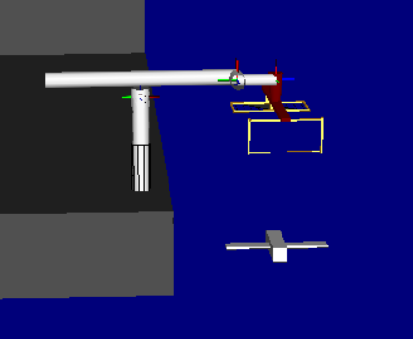
Drone Recovery Robot
Matt Kennedy
John Furumo
Snapshot of Robot Model
from RoboWorks

Slide 2

sketch start, end, intermediate configurations of part
show how the part is to be inserted/connected/etc.
show roll, pitch, yaw at several configurations
show the volume of the workspace required for tool tip
9-DEC-2019
ENAE692/Robot Project

Slide 3

Kinematic Requirements
  Position DOFs/Range
  Orientation DOFs/Range
Workspace Requirements
  Reachable (tool position)
  Dexterous (tool orientation)
Force Requirements
  Force (x-y-z)
  Moment (Mx-My-Mz)
Other
  Obstacle Avoidance
9-DEC-2019
ENAE692/Robot Project

Slide 4

Description | Specification
Total Degrees of Freedom | 7
Arm Type* | YPRP
Wrist Type† | PYR (IAW-No)
Redundancy | elbow orbit angle
Length Sum (L) | 50 cm
Structural Length Index (Q) | 1.8
*R=roll, P=pitch, Y=yaw, D=prismatic
†IAW-intersecting axis wrist
9-DEC-2019
ENAE692/Robot Project

Slide 5
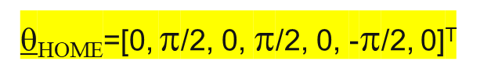
Robot Design (Link Frames)
Θ₂
d4
Θ₇
Top View
z1, z2, x3
x1,x2
x4,x5
z4
z7
z6
Θ₃
Θ₅
Θ₆
z3
z5
x6,x7
z1, z2, x3
x4,x5
z7
d4
Θ₅
Θ₇
Θ₃
Side View
x1,x2
z4
z6
z3
z5
x6,x7
Θ₆
Θ₂
d1
z0
tern device
x0
9-DEC-2019
ENAE692/Robot Project

Slide 6
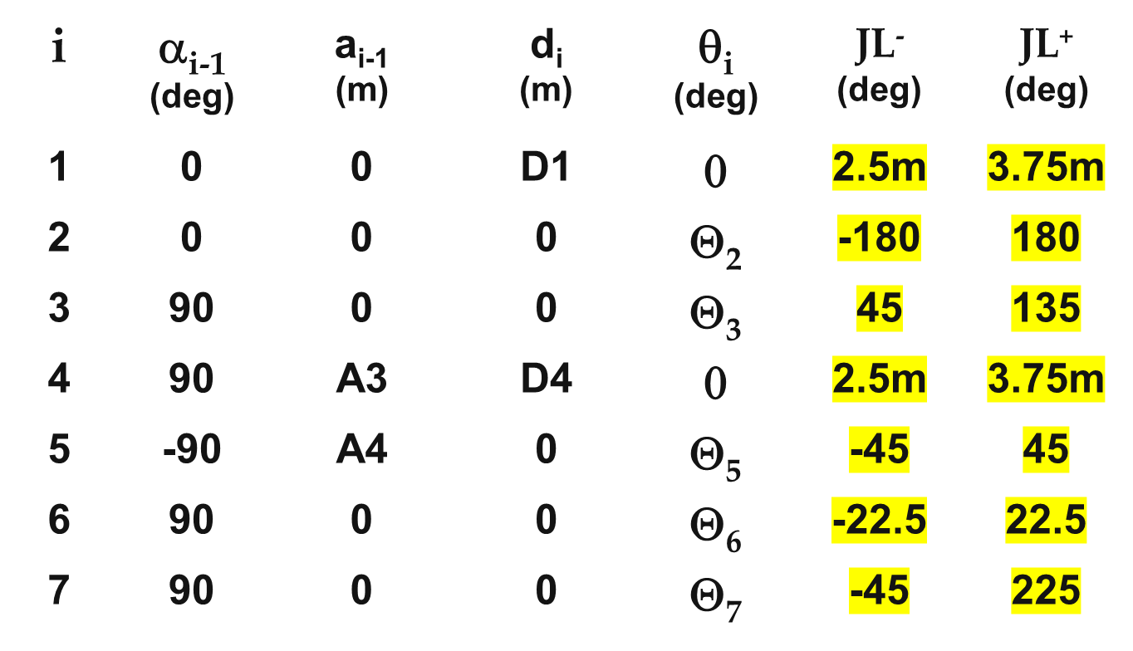
Robot Design (D-H Table)
JL = JOINT LIMIT
9-DEC-2019
ENAE692/Robot Project

Slide 7
Robot Design (Joint Animation)
My Awesome Robot
(Show the motion of each joint in RoboWorks)
9-DEC-2019
ENAE692/Robot Project

Slide 8

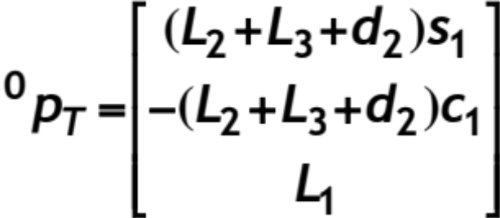
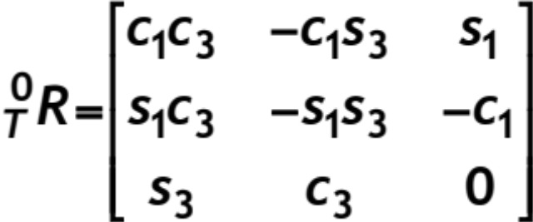
I retyped these equations using Equation Editor, but you can also “Copy As” a BITMAP Pict in Mathematica and then paste them in
[DO NOT INCLUDE IN ORAL PRESENTATION]
9-DEC-2019
ENAE692/Robot Project

Slide 9
snapshot
q = [0,π/2,0,-π/4,π/2,0]:
  p0T=[0,-0.9,0.2]
  R0T=[1,0,0; 0,0,-1; 0,1,0]
q = [] =>
  p0T=
  R0T=
q = [] =>
  p0T=
  R0T=
snapshot
[DO NOT INCLUDE IN ORAL PRESENTATION]
snapshot
9-DEC-2019
ENAE692/Robot Project

Slide 10
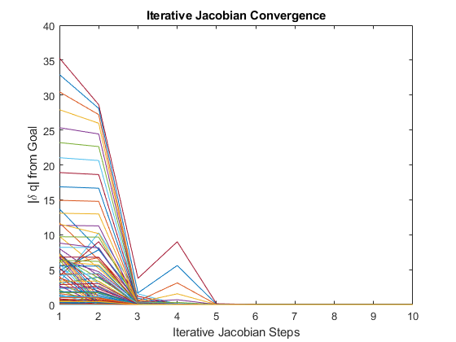
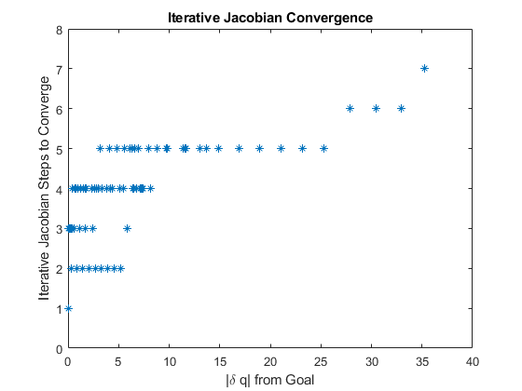
Inverse Kinematics (Solution)
9-DEC-2019
ENAE692/Robot Project

Slide 11
q_{START} = [ ]
⁰p_{GOAL}= [ ], ⁰R_{GOAL}= [ ]
show start configuration
Solution:
q_{GOAL} = [ ]
[DO NOT INCLUDE IN ORAL PRESENTATION]
show end configuration
Solution Check:
⁰p_{T} (q_{GOAL}) = [⁰p_{GOAL}]?
9-DEC-2019
ENAE692/Robot Project

Slide 12
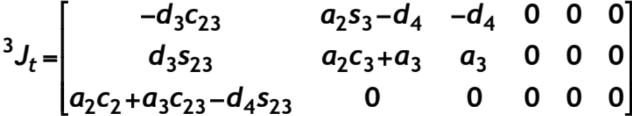
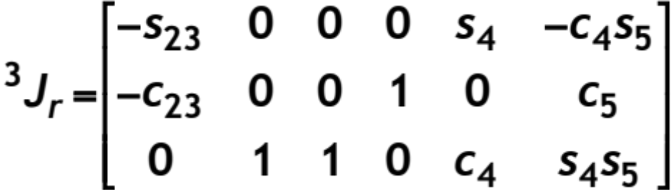
[DO NOT INCLUDE IN ORAL PRESENTATION]
9-DEC-2019
ENAE692/Robot Project

Slide 13
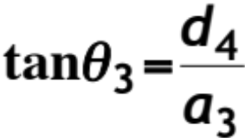

singularity
Boundary:
Internal:
linearly dependent columns
singularity
Select and “Copy As” BITMAP Pict in Mathematica and then paste into PowerPoint
9-DEC-2019
ENAE692/Robot Project

Slide 14

Maximum Task Force/Torque:
F_{MAX} = [ ], N_{MAX} = [ ]
Workspace Pose:
⁰p_{T}= [ ], ⁰R_{T}= [ ]
Joint Position:
q_{T}= [ ]
Show the configuration in which the maximum load occurs and the direction of the applied force/torque.
ϑ^{Τ}(θ)
τ = [ ]
(Joint Torques)
9-DEC-2019
ENAE692/Robot Project

Slide 15
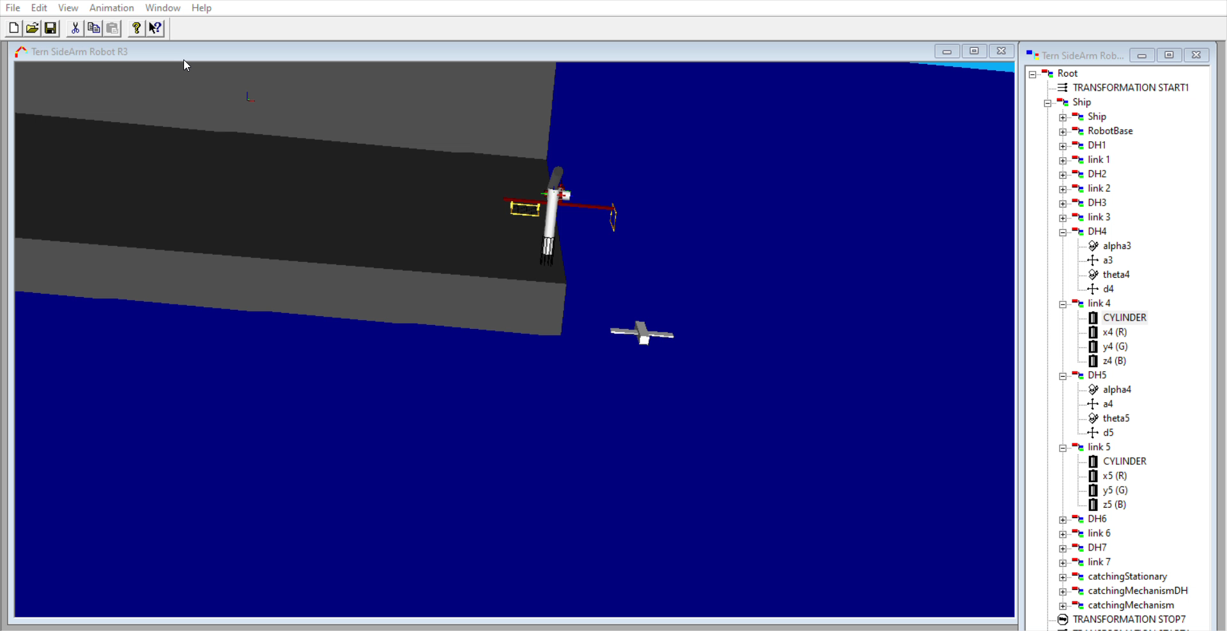
Task (Animation)
Task Animation
(Show task execution in RoboWorks)
*Note: required for teams of 2
9-DEC-2019
ENAE692/Robot Project

Slide 16
Robot Design
  Workspace adequate?
  Singularities a problem?
  Kinematic Redundancy?
Future Work
  Improvements?
  Other Potential Applications?
What I Learned
  About Design
  From Building RoboWorks Model
9-DEC-2019
ENAE692/Robot Project

Slide 17
Back-up
9-DEC-2019
ENAE692/Robot Project

Slide 18
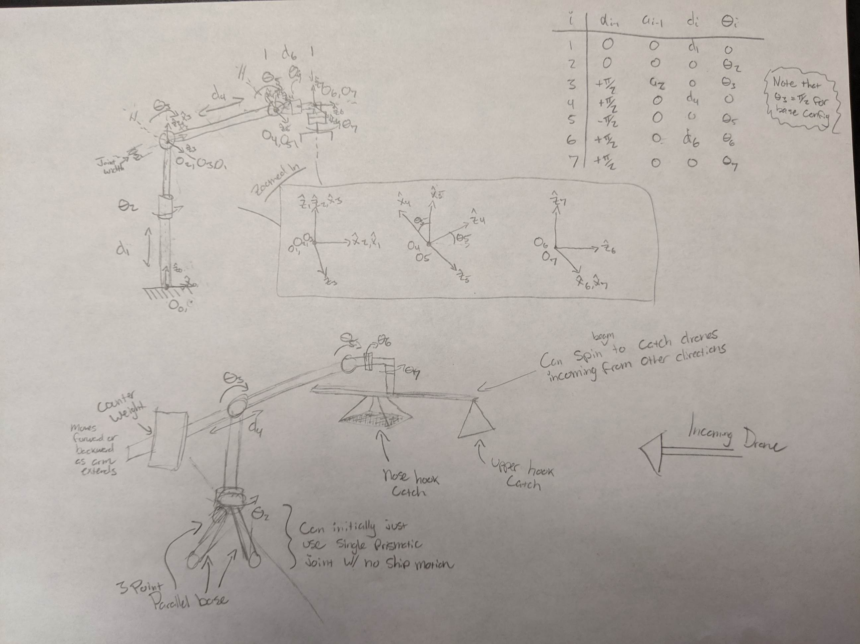
9-DEC-2019
ENAE692/Robot Project

Slide 19
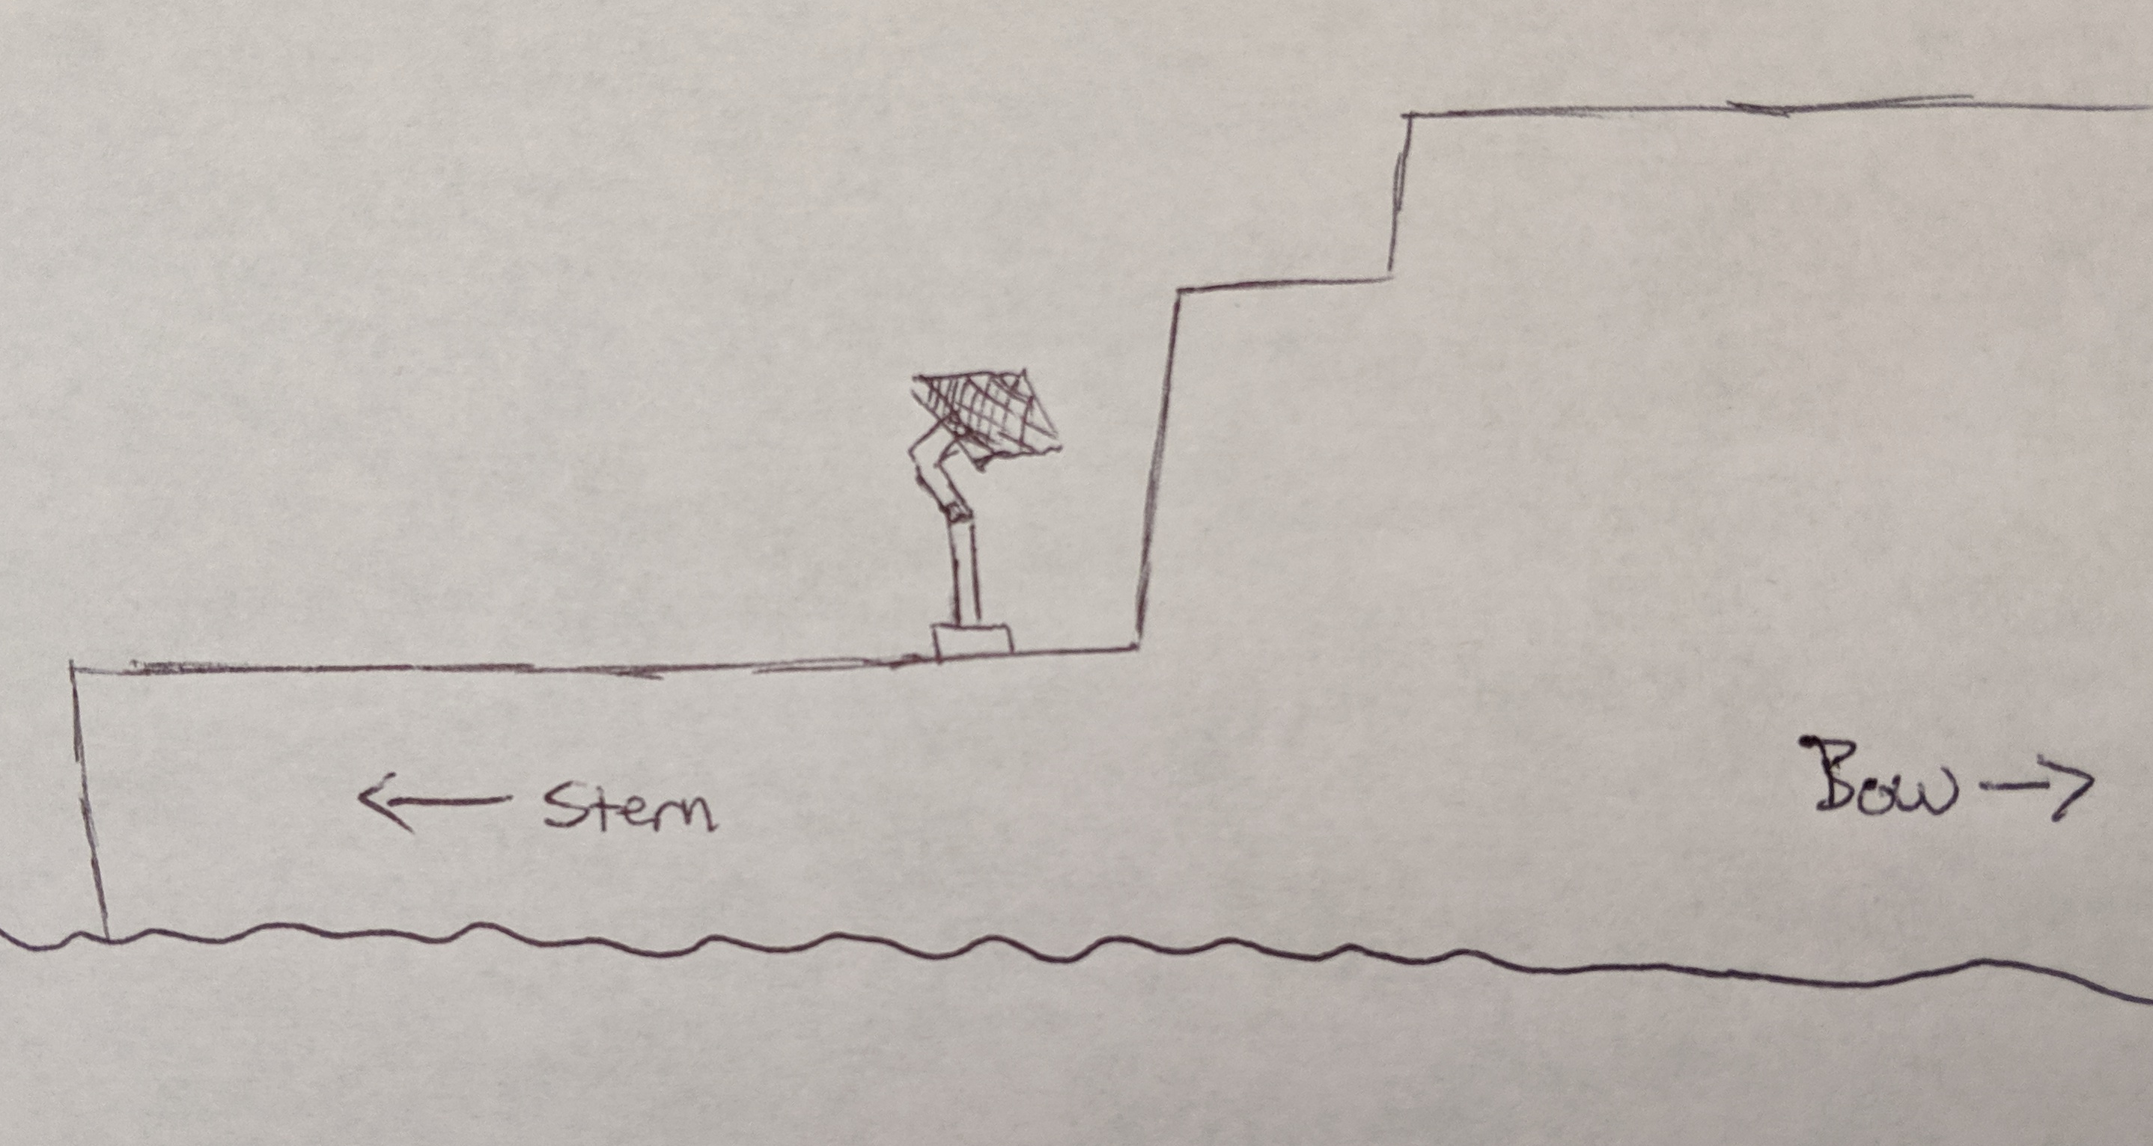
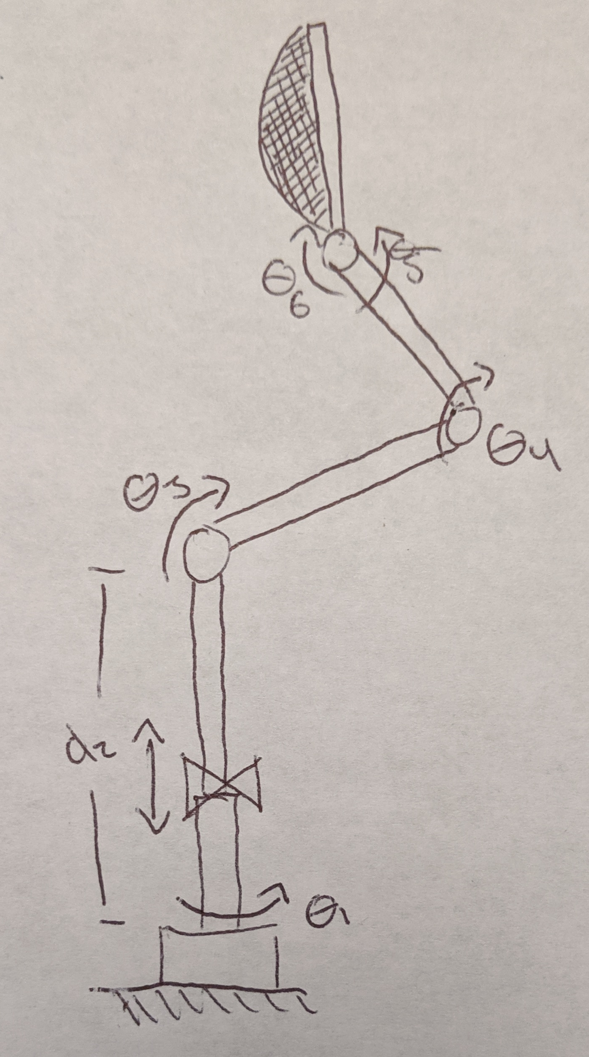
Drone Recovery Arm
Team: Matt Kennedy
John Furumo
Objective:
Design a manipulator capable of safely recovering both fixed wing and rotary drones to an underway ship.
Motivation:
• Facilitate drone recovery in all weather
• Facilitate drone recovery to all ship types
Task Requirements:
Kinematics
  3 DOF to orient the catching mechanism
  3 DOF to adjust height and stabilize tool tip
Workspace
  Orient catching mechanism to 1m (width) by 2m (height) target area
  Lower catching mechanism to ground for drone removal
Force/Moment
  Impact with 40kg drone moving 10m/s (for fixed wing)
Drone Recovery Arm mounted to LCS Flight Deck
Robot Design:
Initial concept uses 5 revolute joints for positioning and orientation, and a prismatic joint near the base for additional stabilization.
The estimated required arms lengths are:
D2 = 2-3m
L3 = 1m
L4 = 1m
Though design requirements will be further investigated for optimal workspace to ensure safe wave-offs. The end-effector catching mechanism is initially proposed to be a simple net, though the effectiveness of others will be investigated.
23-OCT-2019

